Slide 1

Daily sea Ice Extent In Hemispheres
Course : Capstone
Presented By:
Pon swarnalaya Ravichandran

Slide 2

Contents
Introduction to Dataset
Stationarity
Time Series Decomposition
Holts-Winter Method
Feature Selection
Base Models
Multiple Linear Regression
Rest Of the Project

Slide 3
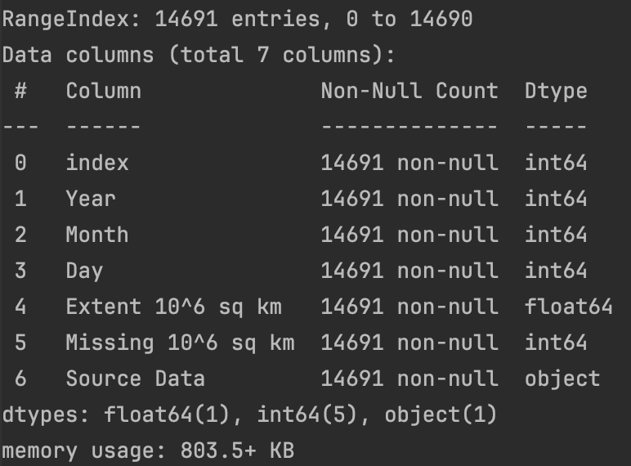
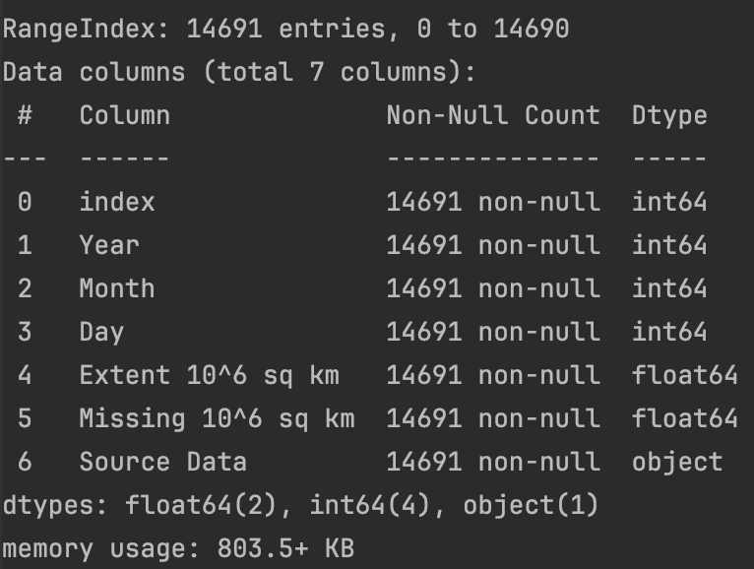
Introduction to Dataset
Northern Hemisphere
Dataset :Daily Sea Ice Extent In Hemispheres Source: Daily Sea Ice Extent datasets from Kaggle
Two datasets, Northern hemisphere and Southern hemisphere.
Both the dataset has the shape of 14691 * 6
The dependent variable is “Extent 10^6 sq km”
The data is not stationary, unbalanced.
There was no Null values in the datasets.
Southern Hemisphere

Slide 4
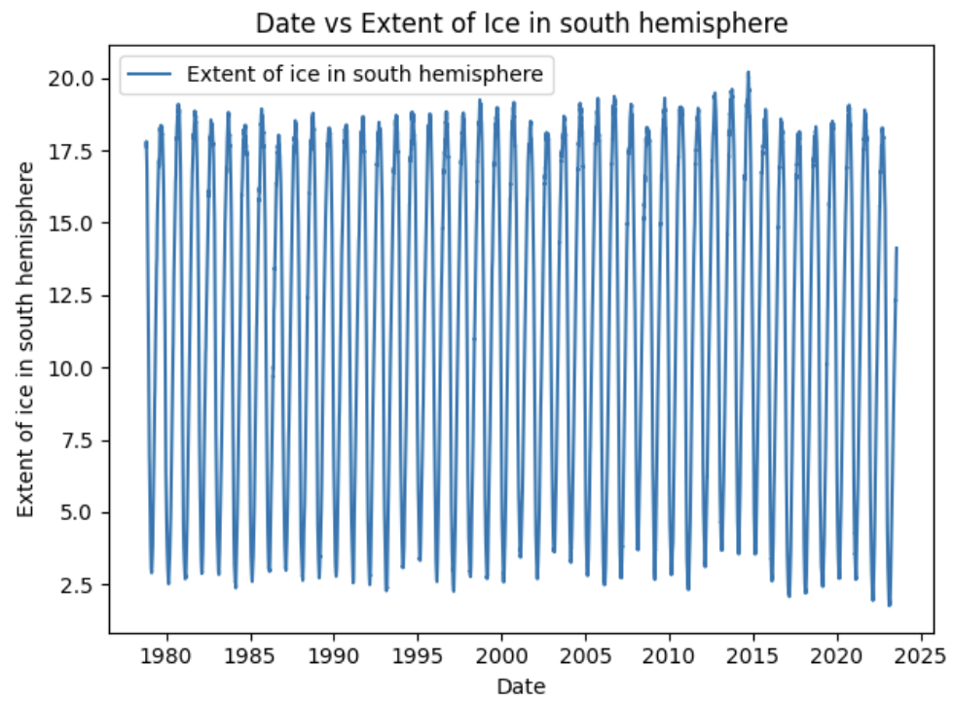
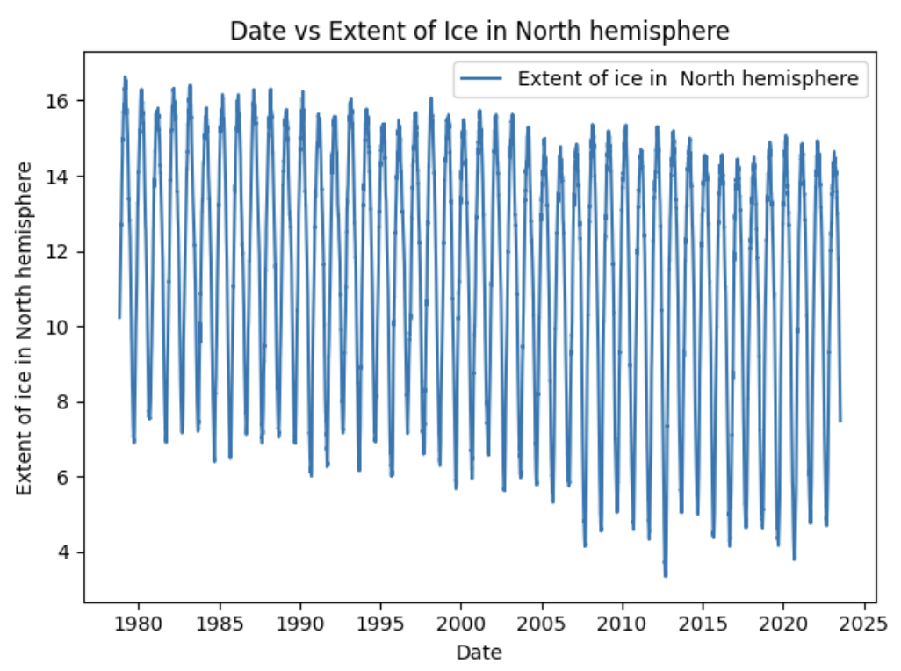
Dataset preprocessing:
From the Plots, it is evident that the data is trended and seasonal.
It’s a daily recorded data, starting from 26th October 1978 to 23rd September 2023.
There are fluctuations in the data because of the weather, temperature and natural environmental changes.
The seasonality cycle is 365.

Slide 5
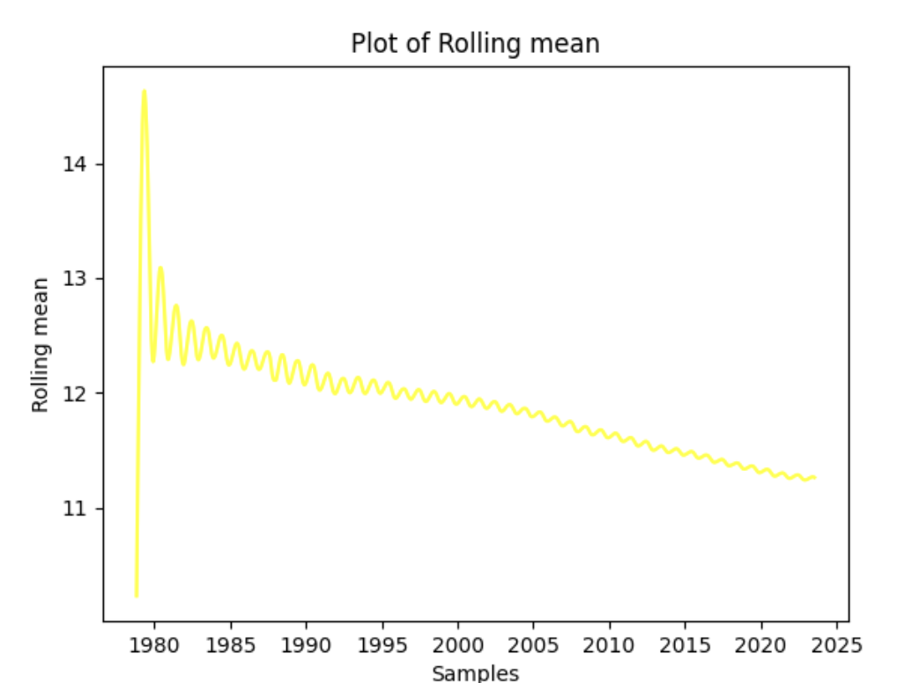
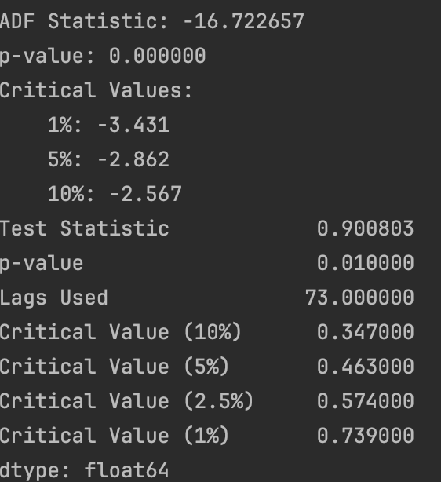
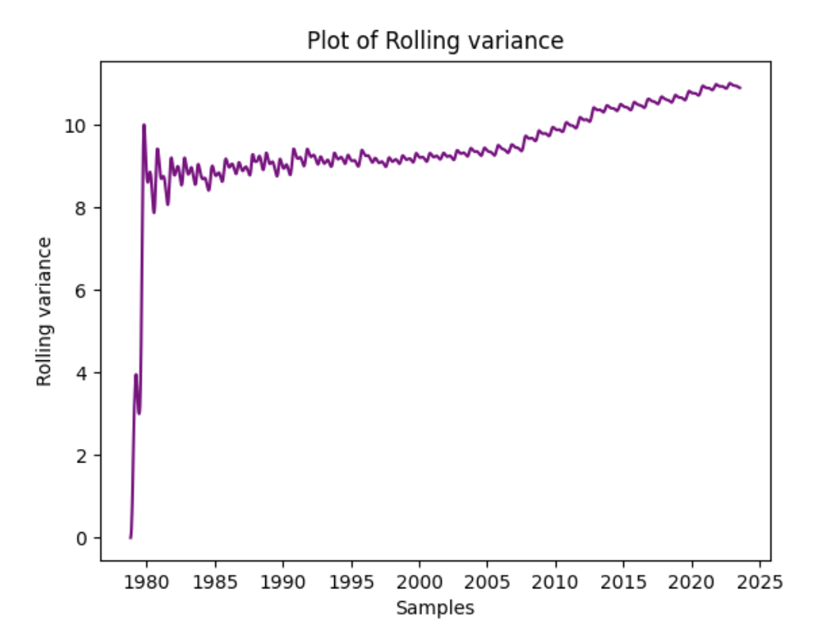
Northern hemisphere
The ADF and KPSS test statistics shows that the data is not stationary
The plot of rolling mean and rolling variance shows that the data is not stable and don’t have a flat point.

Slide 6
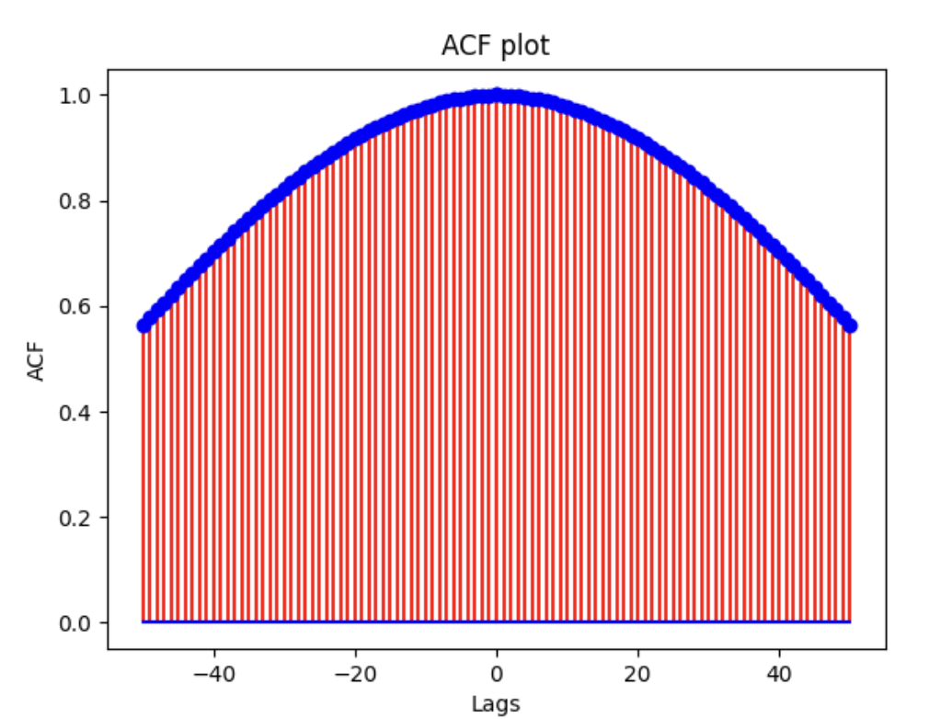
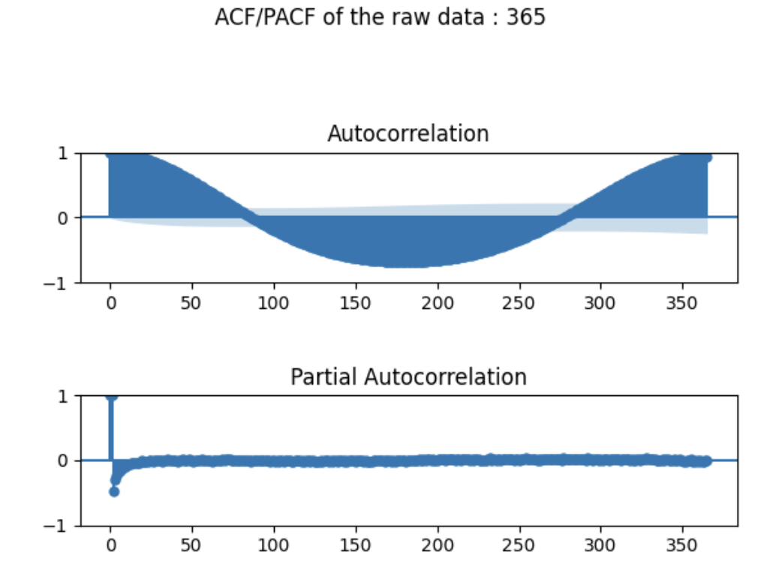
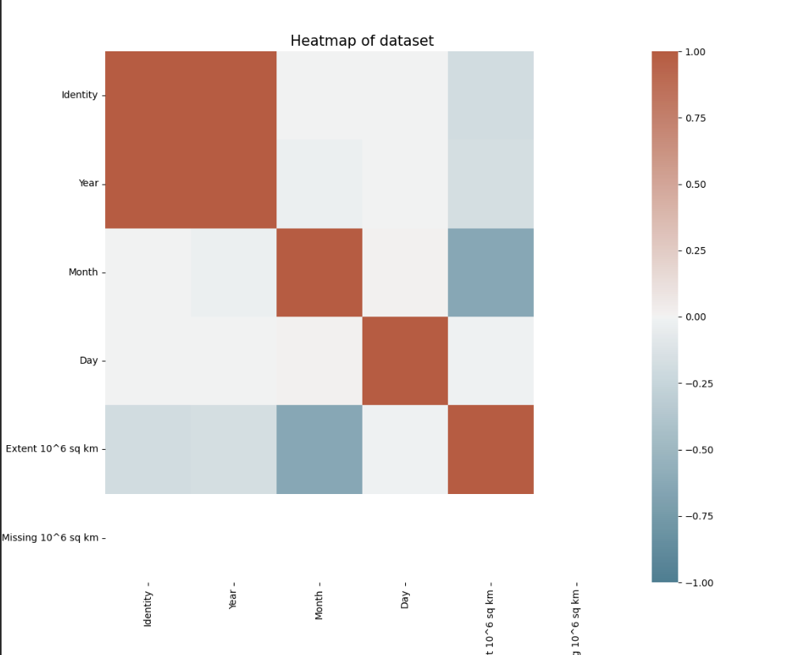
The ACF of plot of raw dataset shows that the data is not white noise.
The ACF/PACF plot shows that the data is seasonal and converges over the time
The given heatmap shows that relatability of the various variable over one other and the correlation between the variables are shown as well.

Slide 7
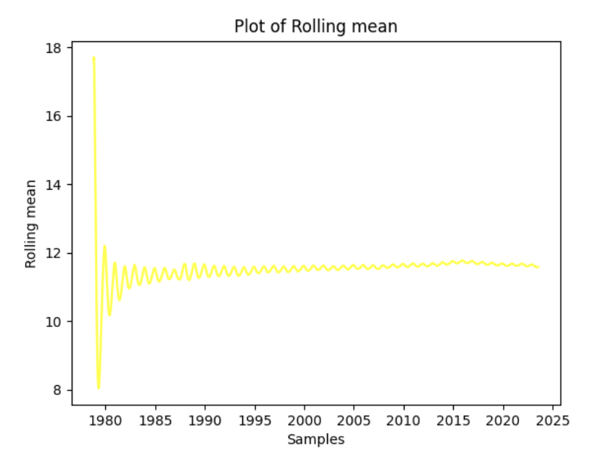
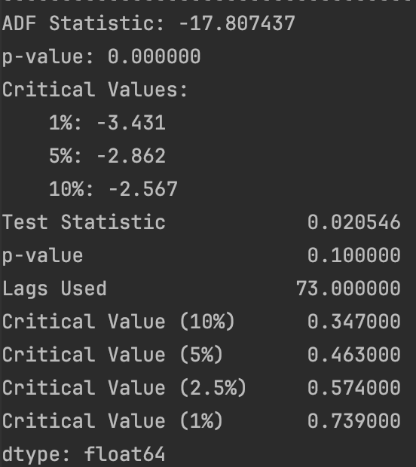
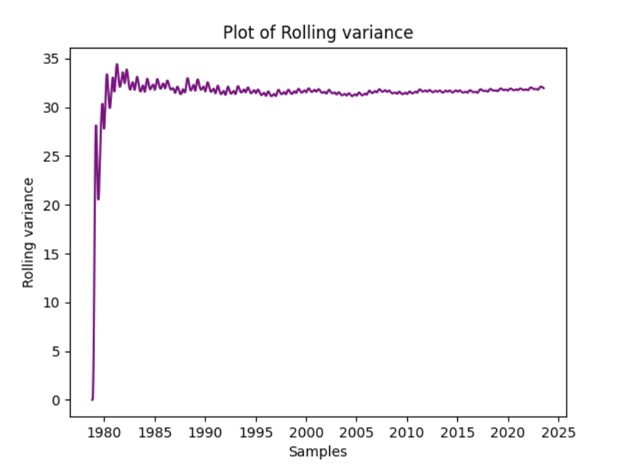
Southern hemisphere
The ADF and KPSS test statistics shows that the data is stationary
The plot of rolling mean and rolling variance shows that the data is not stable and don’t have a flat point.

Slide 8
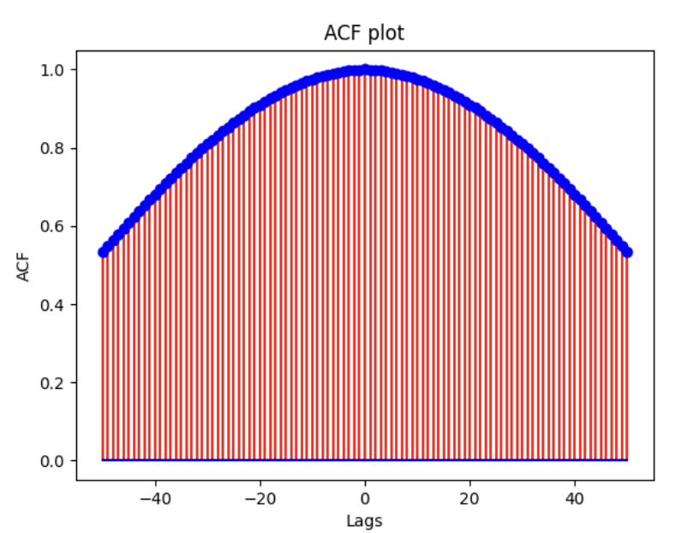
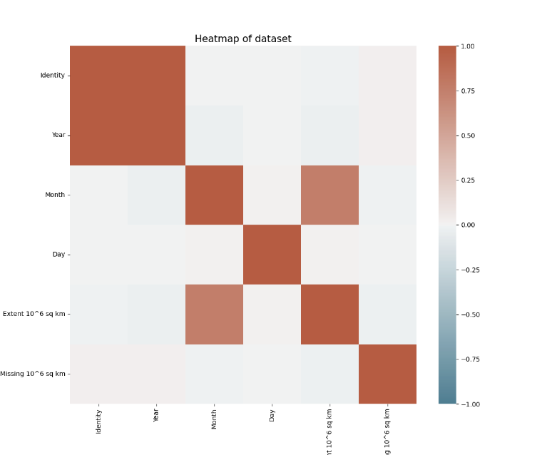
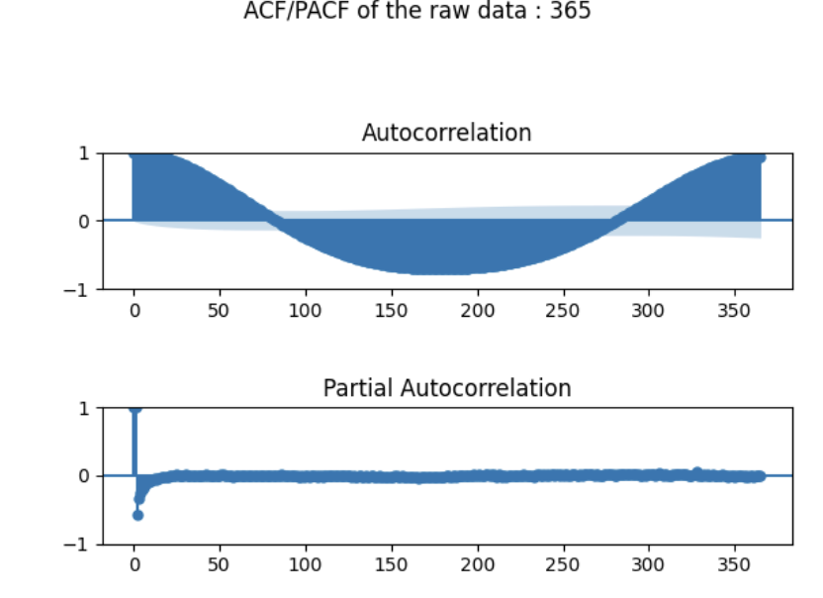
The ACF of plot of raw dataset shows that the data is not white noise.
The ACF/PACF plot shows that the data is seasonal and converges over the time
The given heatmap shows that relatability of the various variable over one other and the correlation between the variables are shown as well.

Slide 9
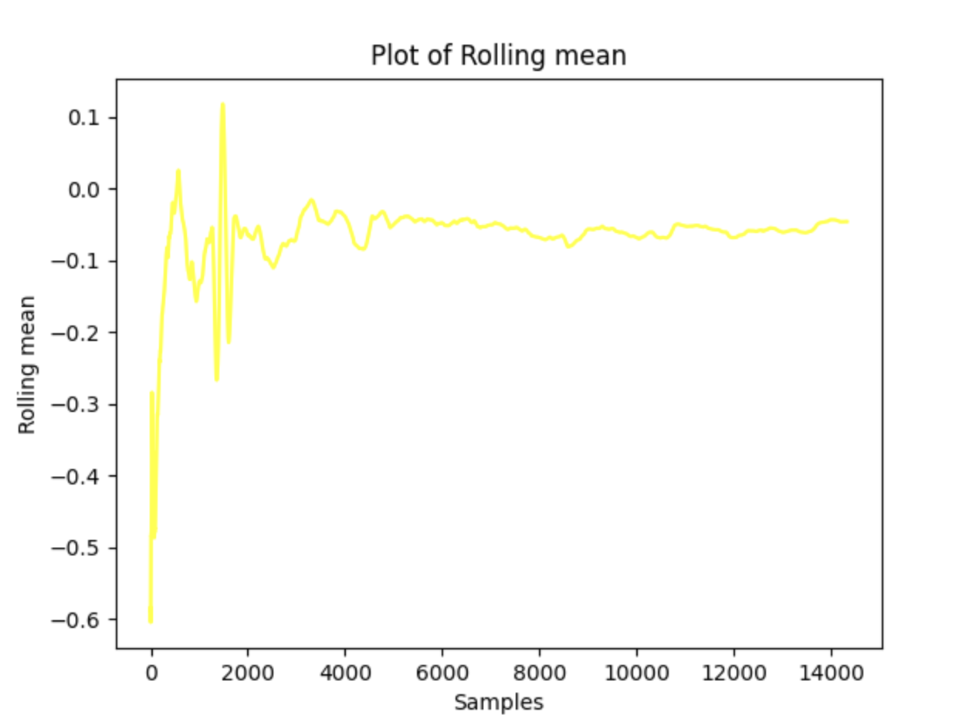
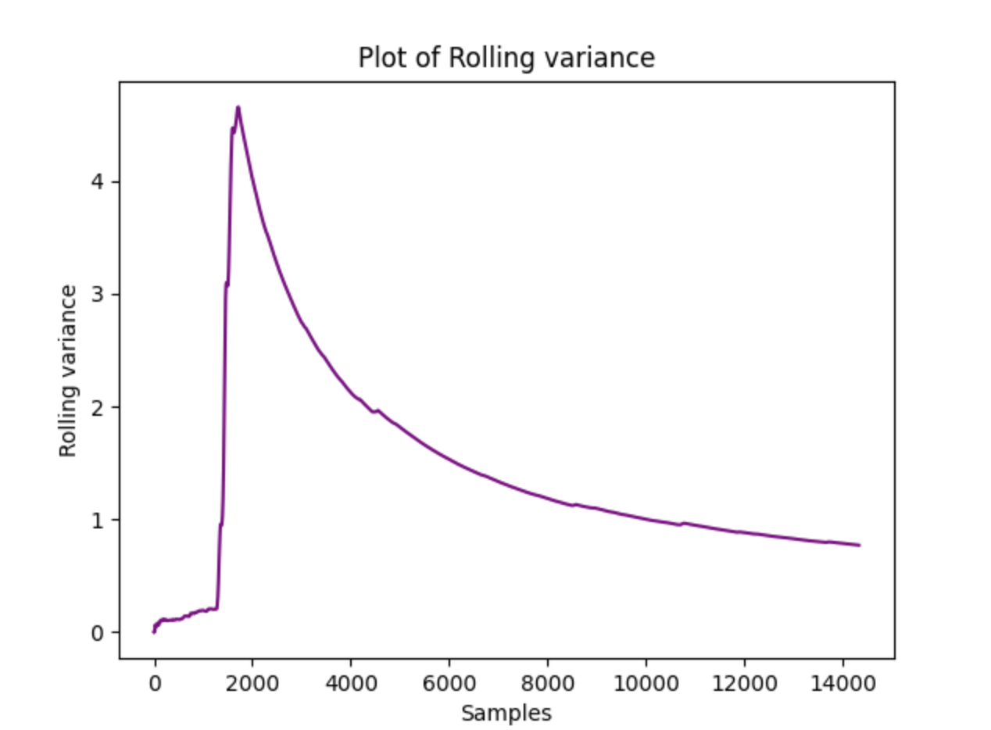
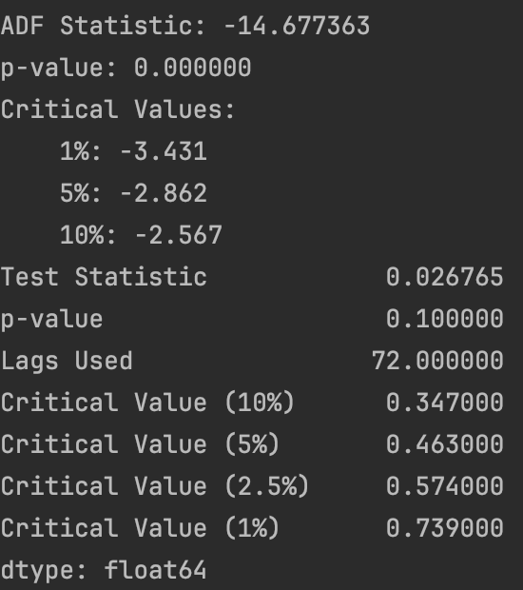
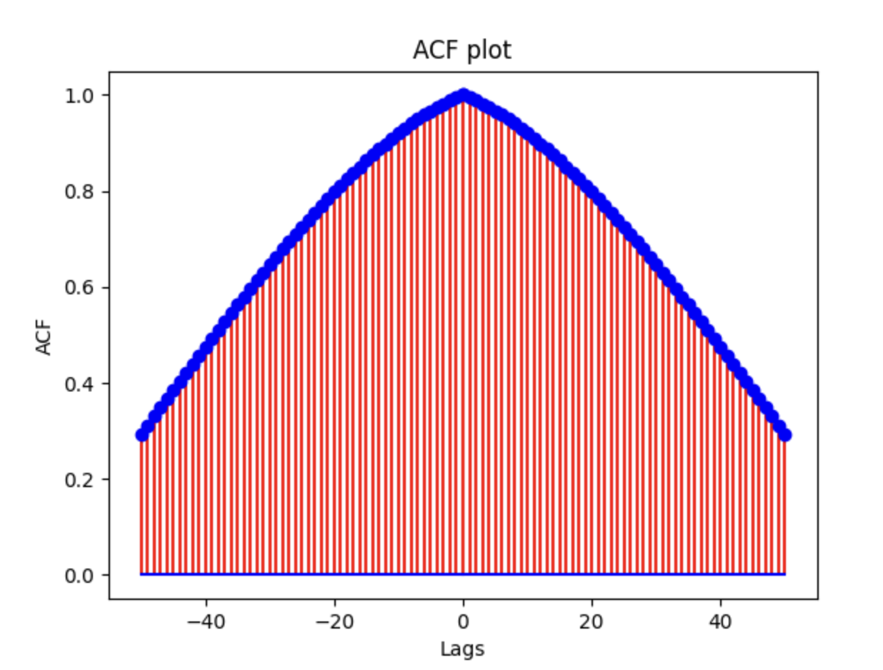
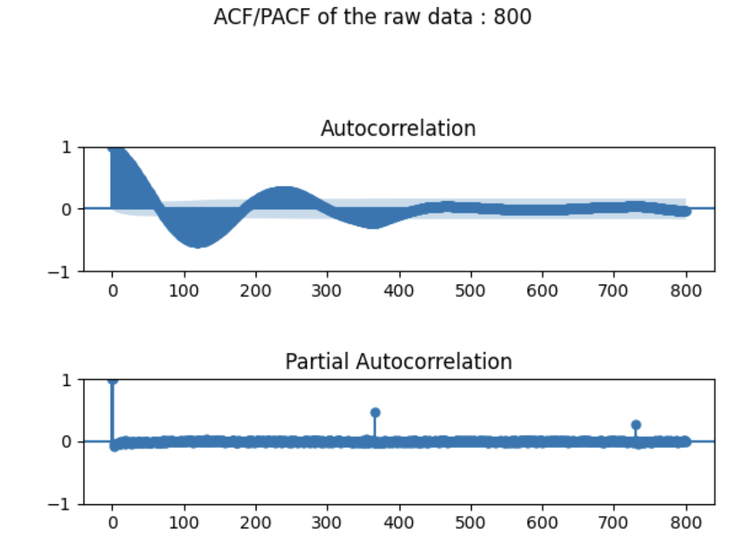
FIRST ORDER DIFFERENCING – NORTHERN HEMISPHERE
The data looks like it is stationary .
The adf and kpss test shows that the data is stationary
But, ACF plot has no white noise and ACF/PACF plot shows a seasonality at 365
The rolling mean and variance doesn’t have a stability and it is fluctuated.

Slide 10
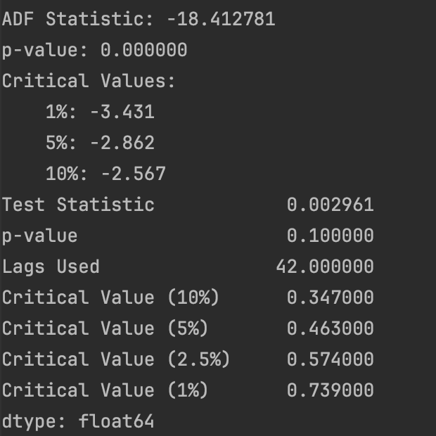
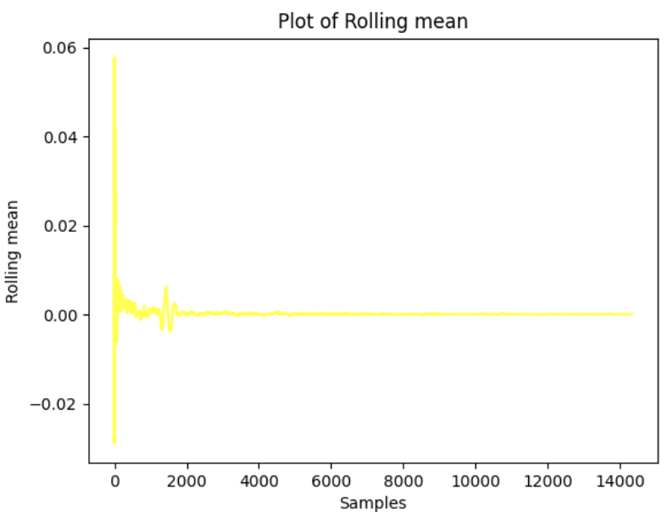
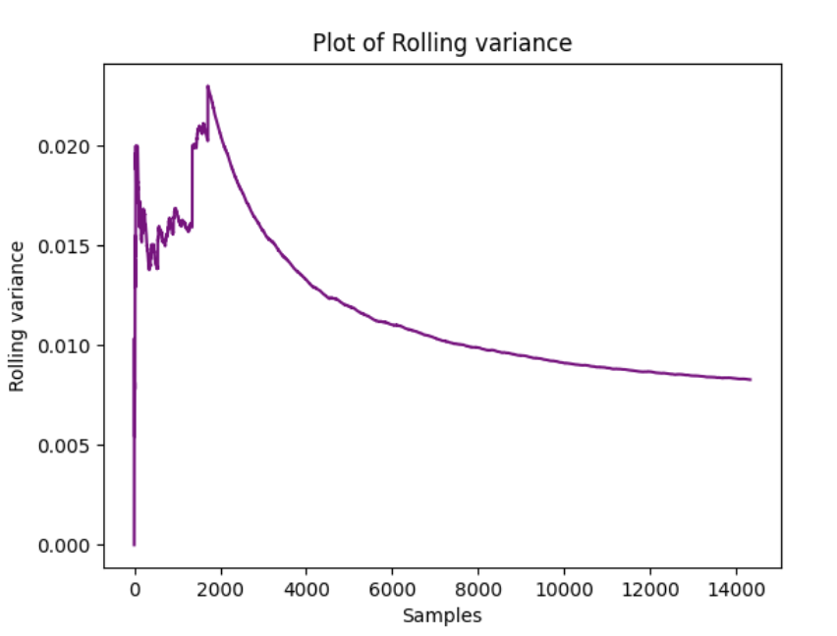
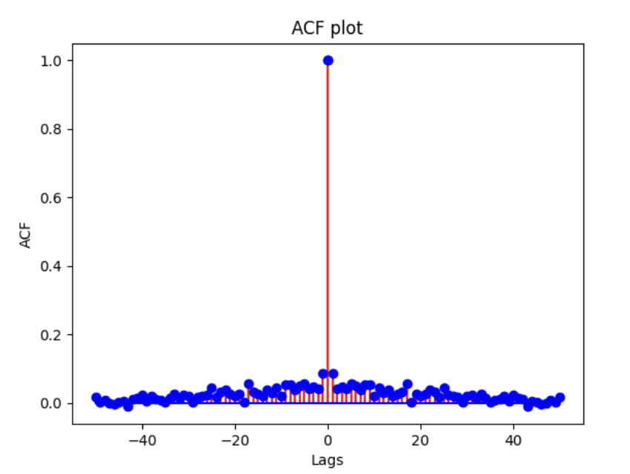
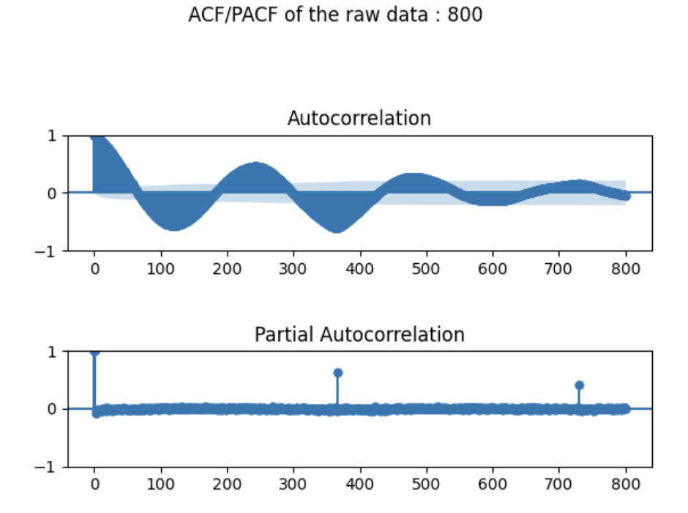
SECOND ORDER DIFFERENCING – NORTHERN HEMISPHERE
The data looks like it is stationary .
The adf and kpss test shows that the data is stationary
ACF plot has white noise and ACF/PACF Plot shows seasonality at 365.
The rolling mean and variance has a flat point and its stable.

Slide 11

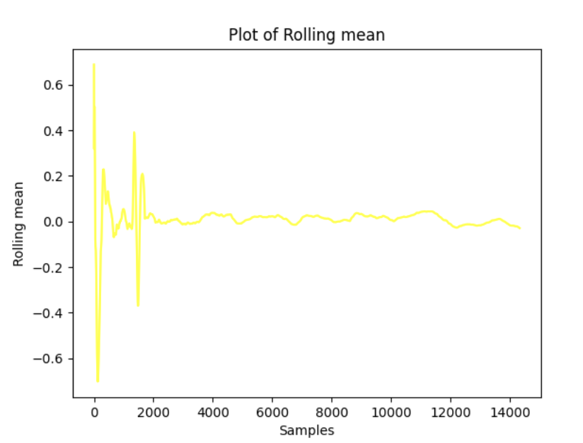
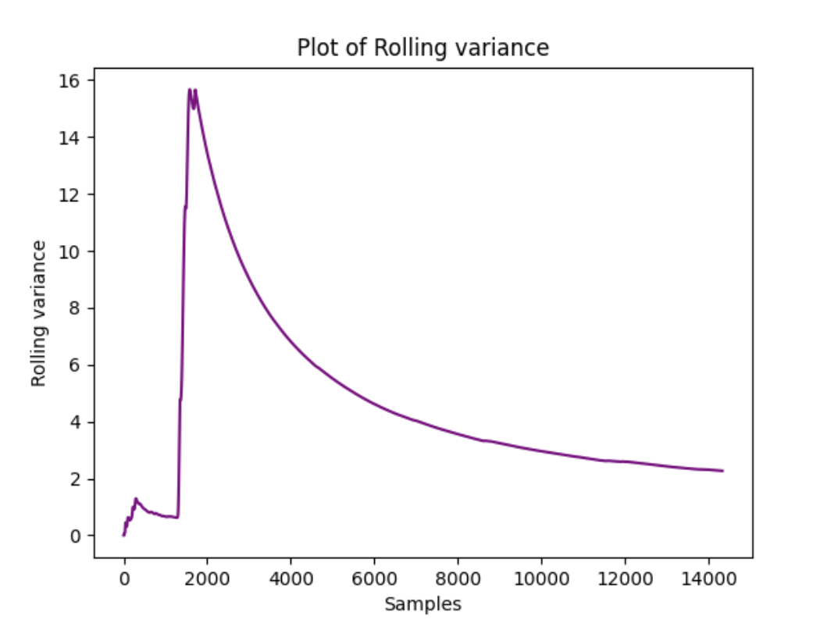
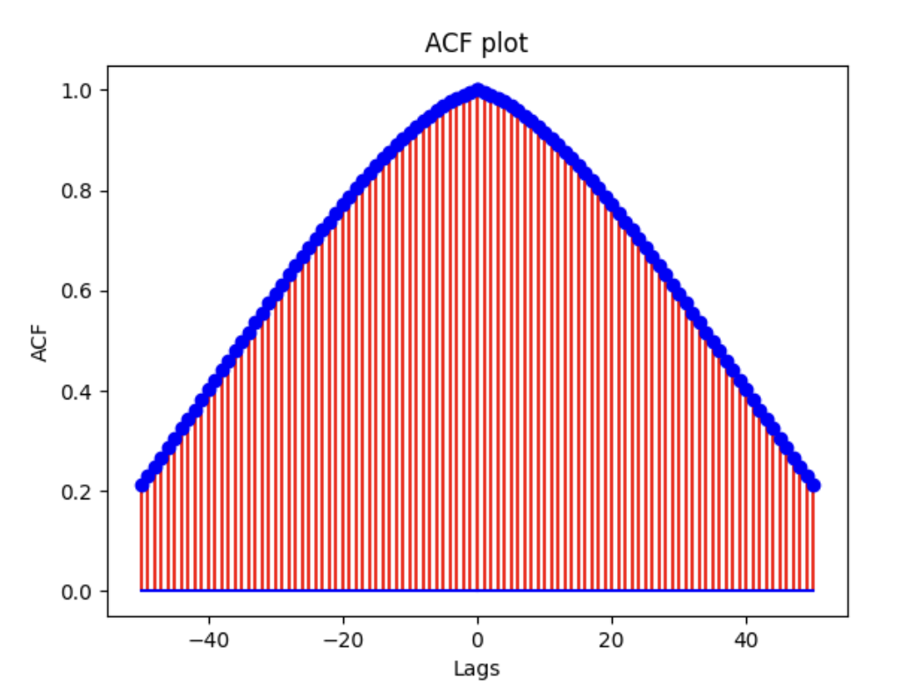
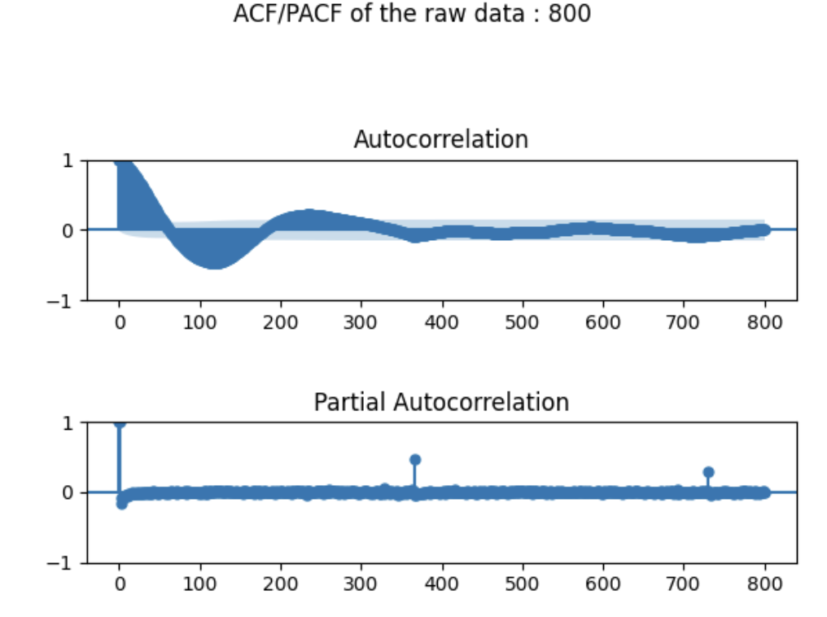
FIRST ORDER DIFFERENCING – SOUTHERN HEMISPHERE
The data looks like it is partially stationary .
The adf and kpss test shows that the data is stationary
But, ACF plot has no white noise and ACF/PACF plot shows a seasonality at 365 in pacf and data converges over time in acf.
The rolling mean and variance doesn’t have a stability and it is fluctuated.

Slide 12

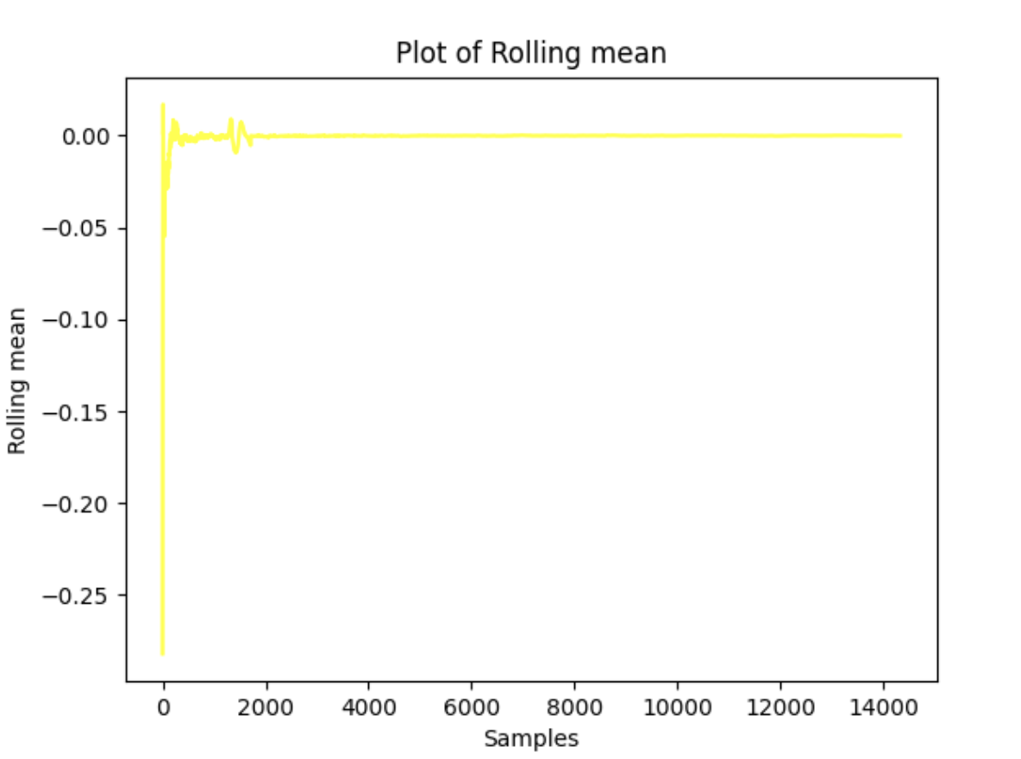
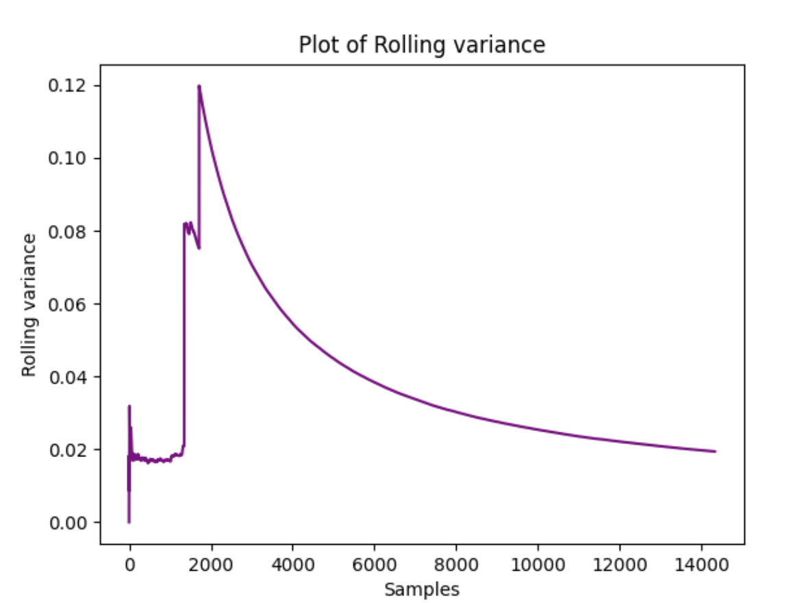
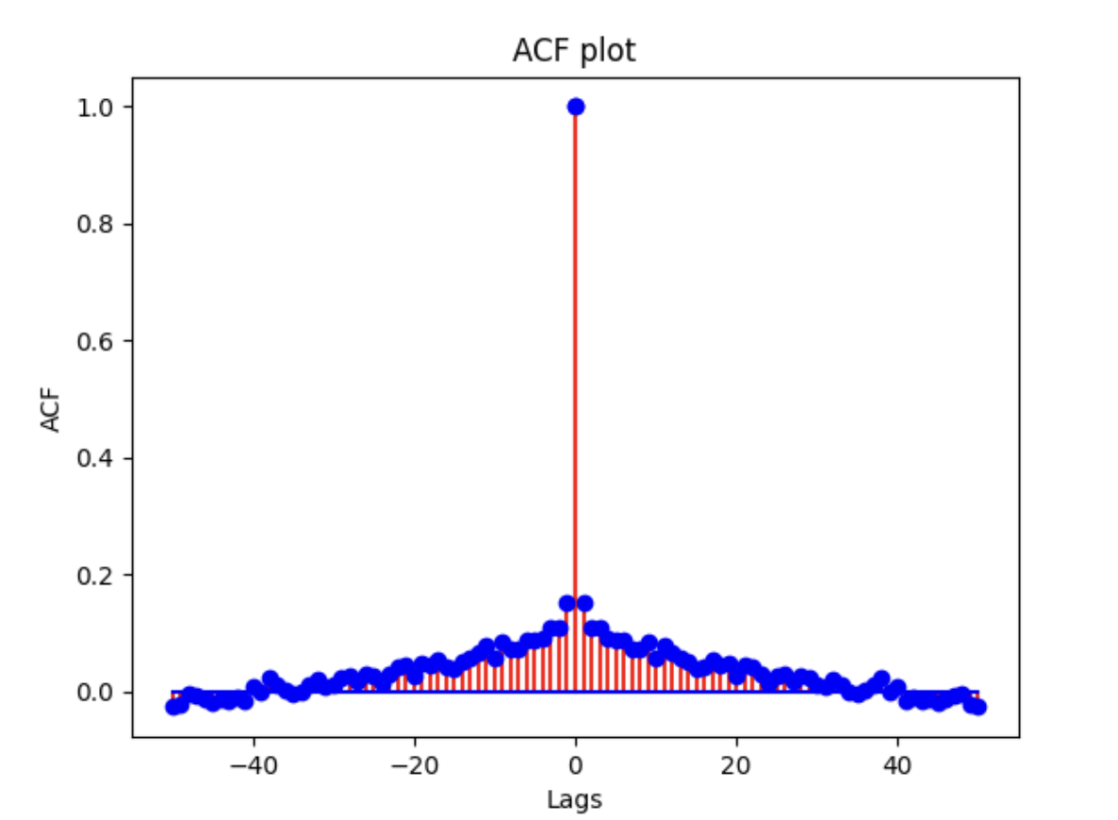
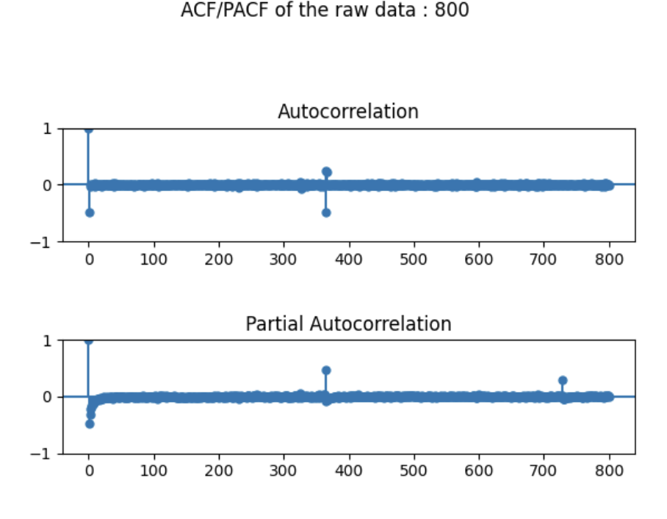
SECOND ORDER DIFFERENCING – SOUTHERN HEMISPHERE
The data looks stationary .
The adf and kpss test shows that the data is stationary
ACF plot has white noise and ACF/PACF Plot shows seasonality at 365.
The rolling mean and variance has a flat point and its stable.

Slide 13
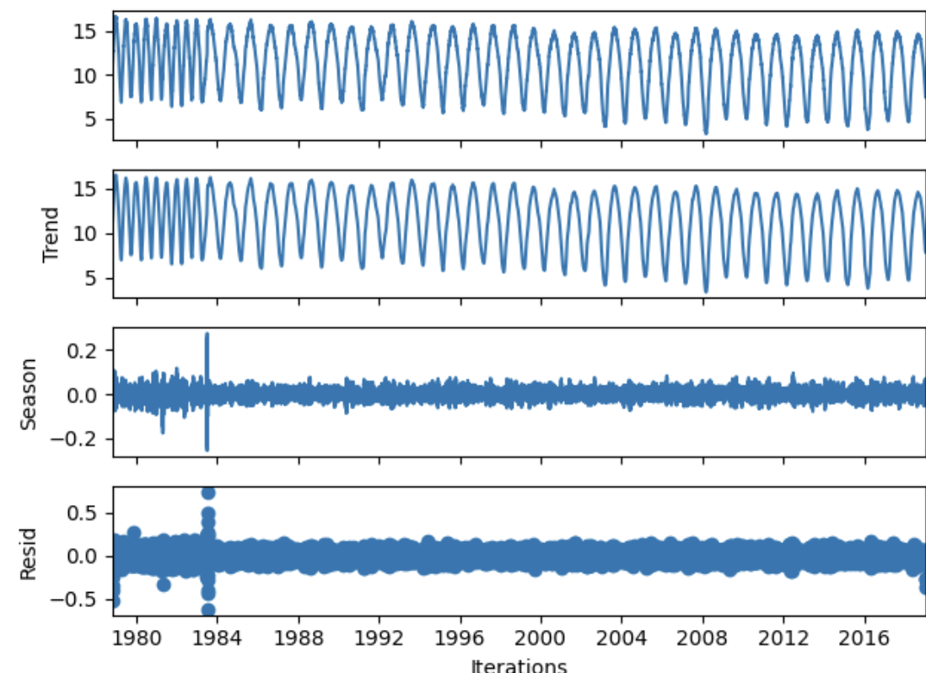
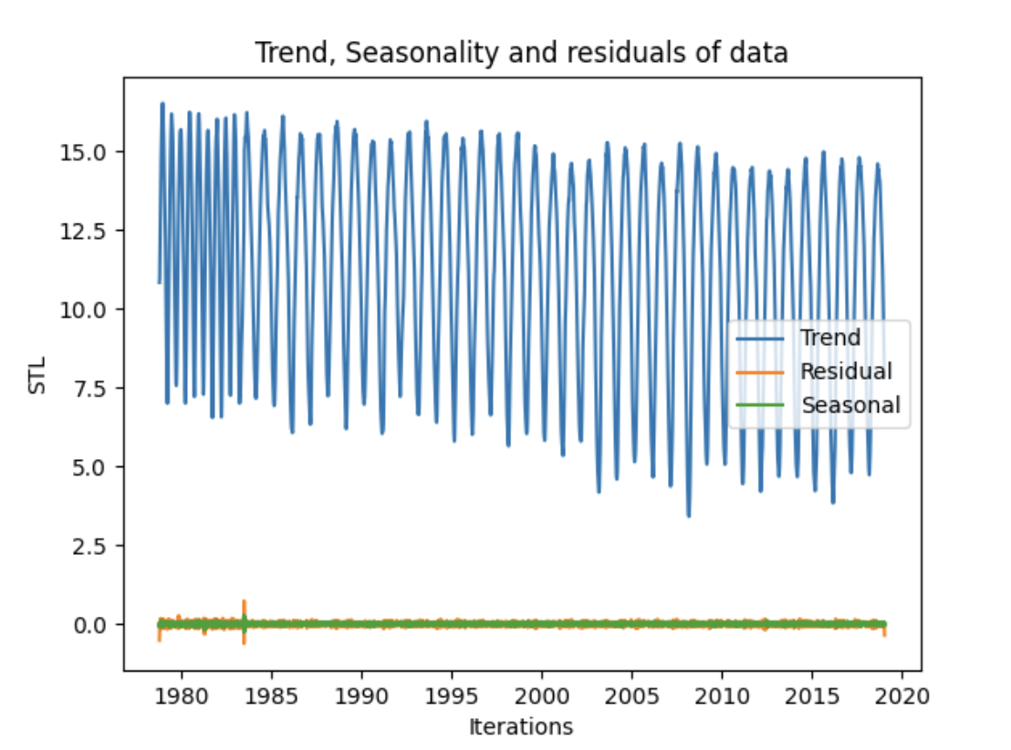
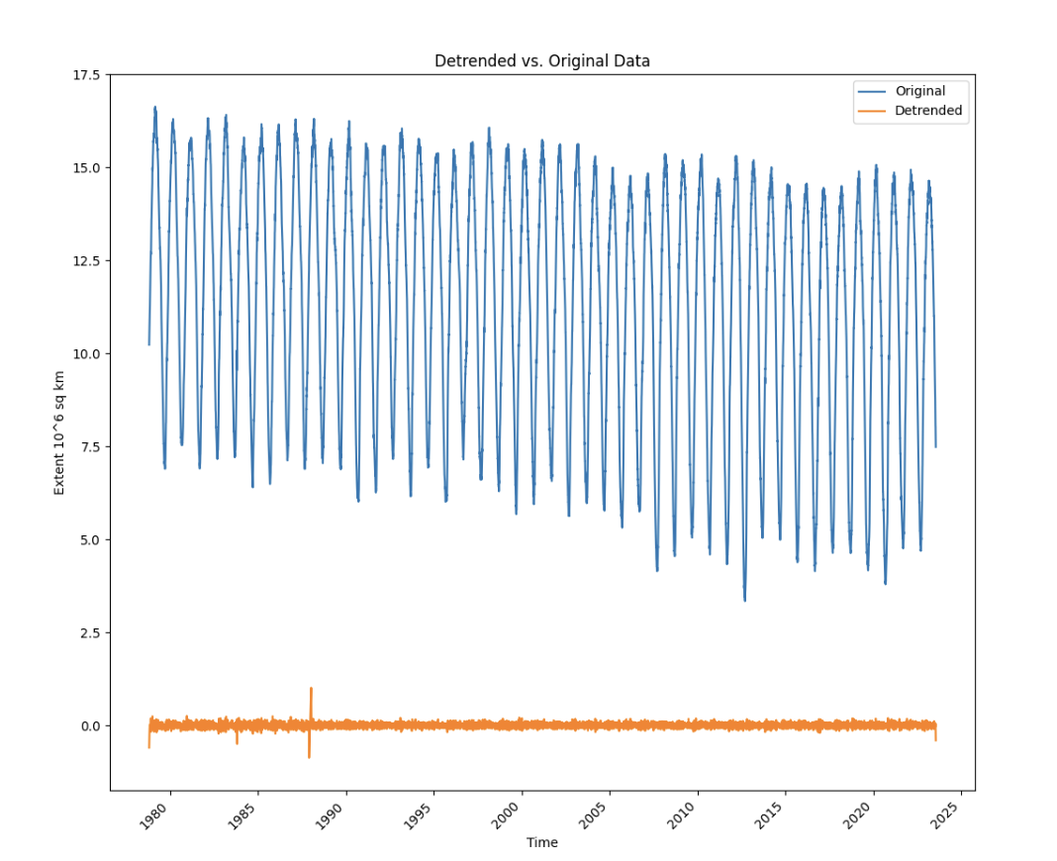
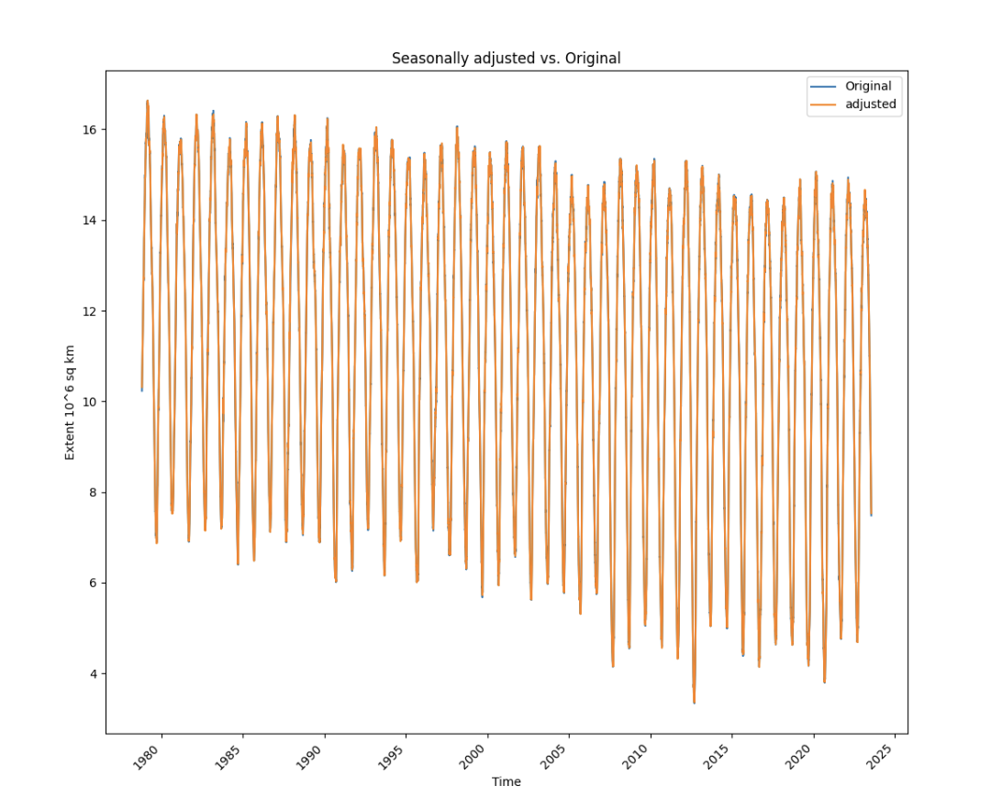
TIME SERIES DECOMPOSITION – NORTHERN HEMISPHERE
The STL plot shows the trend, seasonality and residual of the data.
The seasonally adjusted data shows that the data is completely seasonal and fitted with the original data.
The detrended data is away from the original data
Strength of trend: 0.9998074633231866
Strength of seasonality: 0.2959485111132665

Slide 14
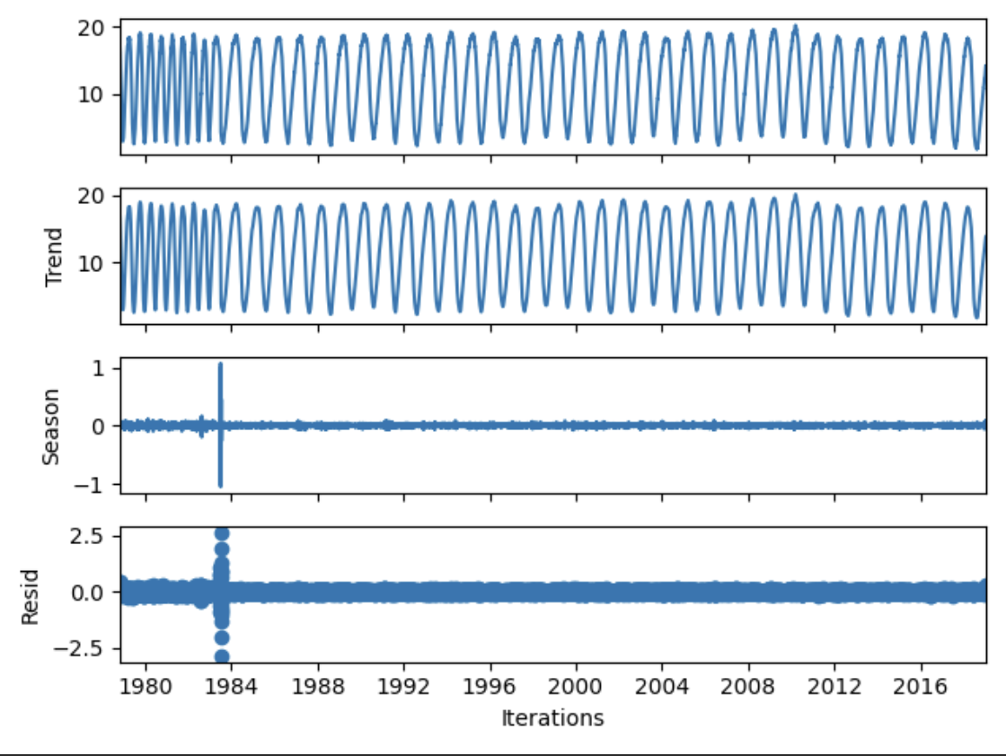
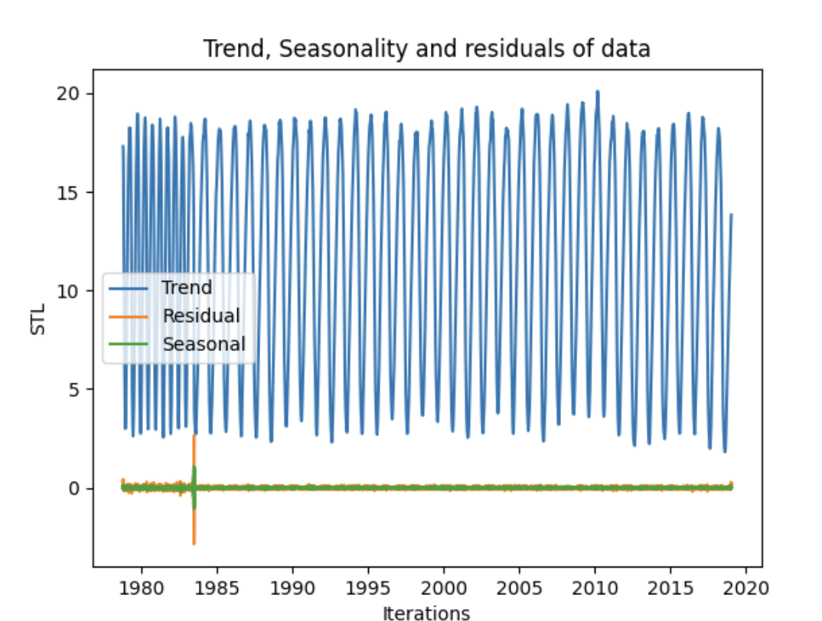
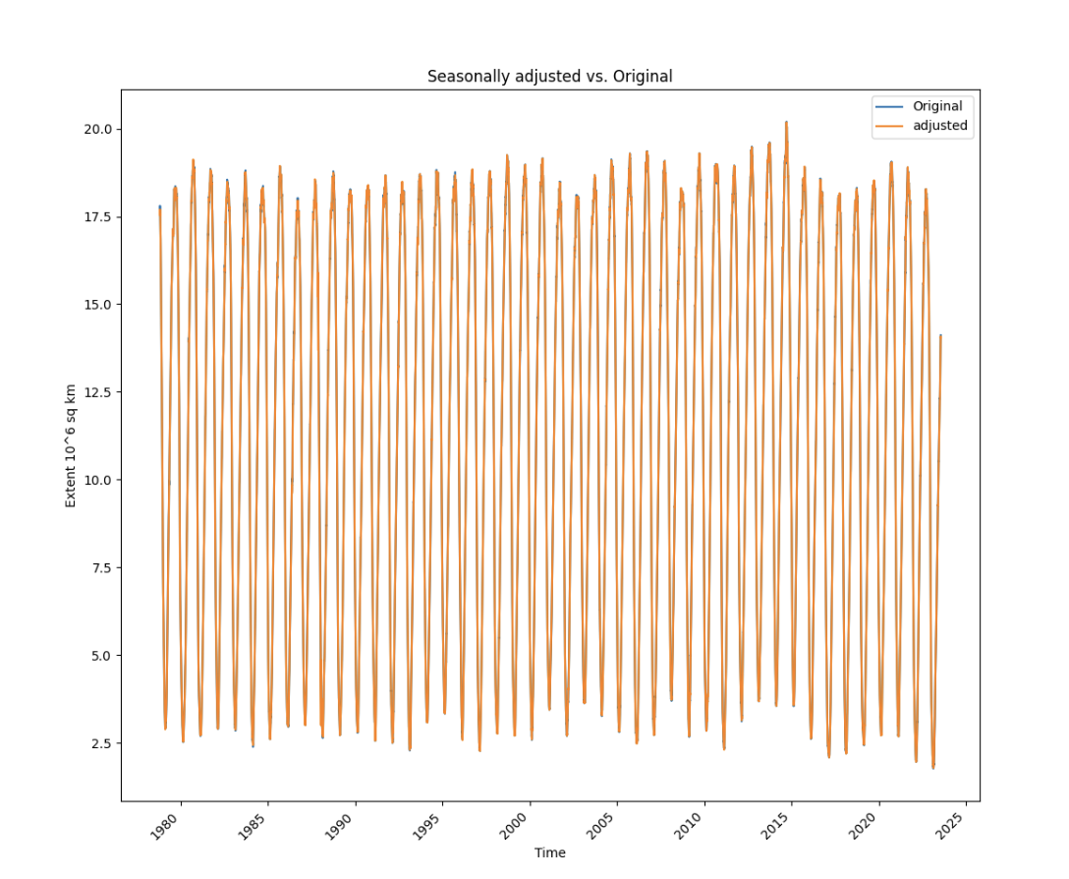
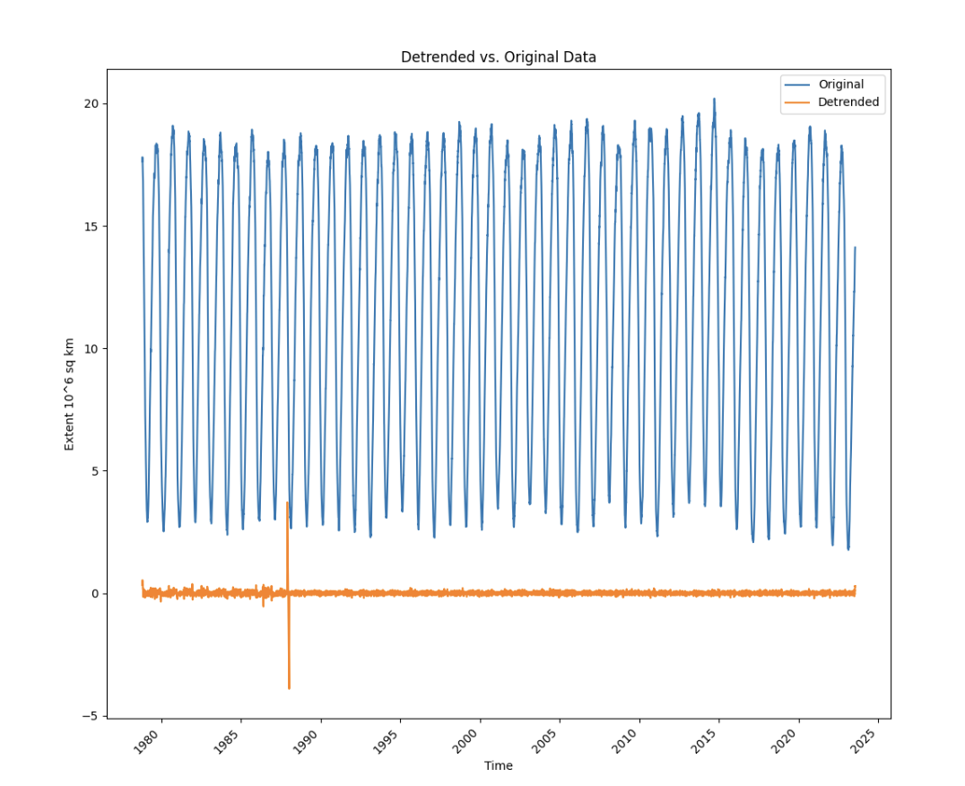
TIME SERIES DECOMPOSITION – SOUTHERN HEMISPHERE
The STL plot shows the trend, seasonality and residual of the data.
The seasonally adjusted data shows that the data is completely seasonal and fitted with the original data
The detrended data is away from the original data.
Strength of trend: 0.999854717847911
Strength of seasonality: 0.2708243049708411

Slide 15
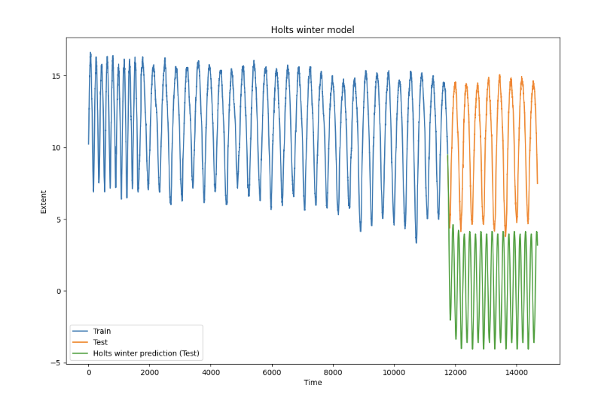
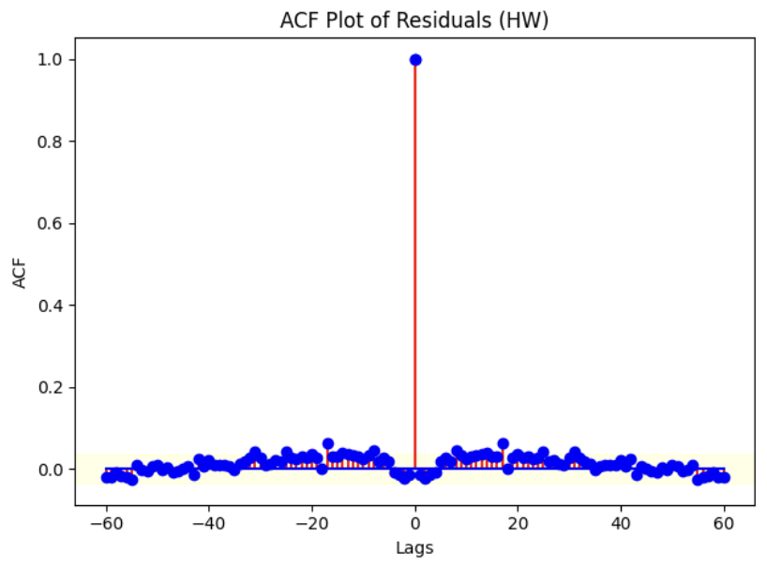
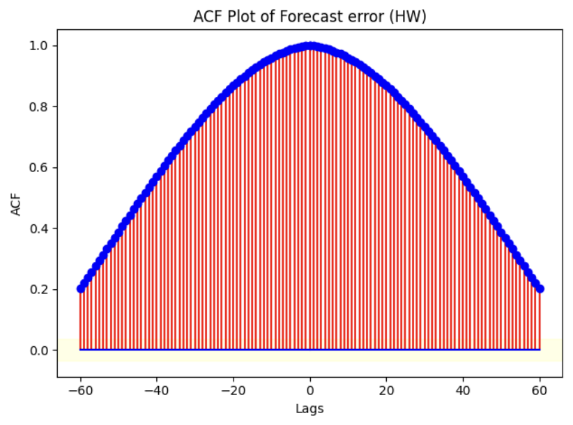
HOLTS-WINTER METHOD - NORTHERN HEMISPHERE
The Holts winter model shows that the train , test and predicted is. not fitted. It shows a clear trend over the test set.
The ACF plot of residuals shows that the data is white and converges over time both in the positive and negative lags in a mirrorly manner.
The ACF plot of the forecasted shows that the data is not white and doesn’t converge over time. Even after 60 lags.

Slide 16
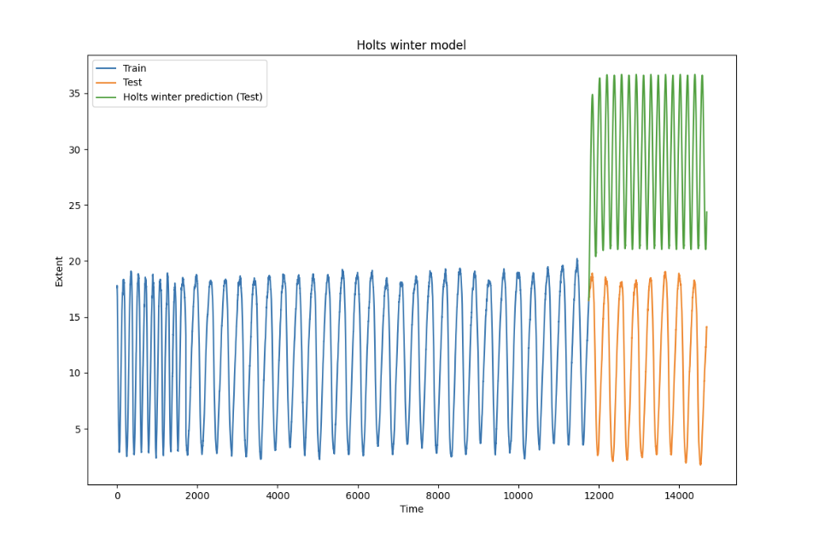
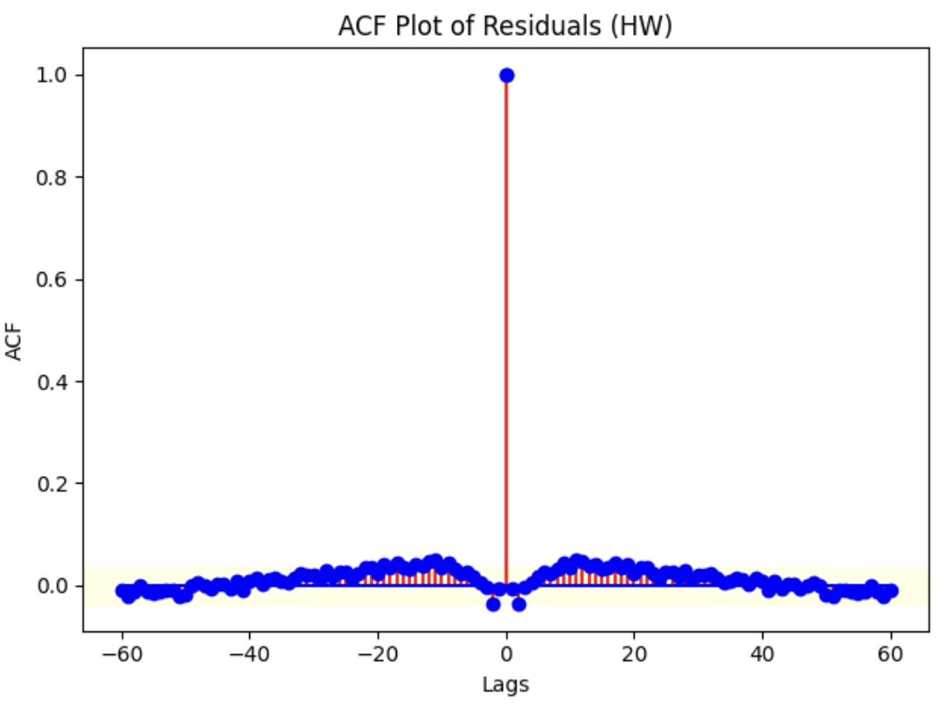
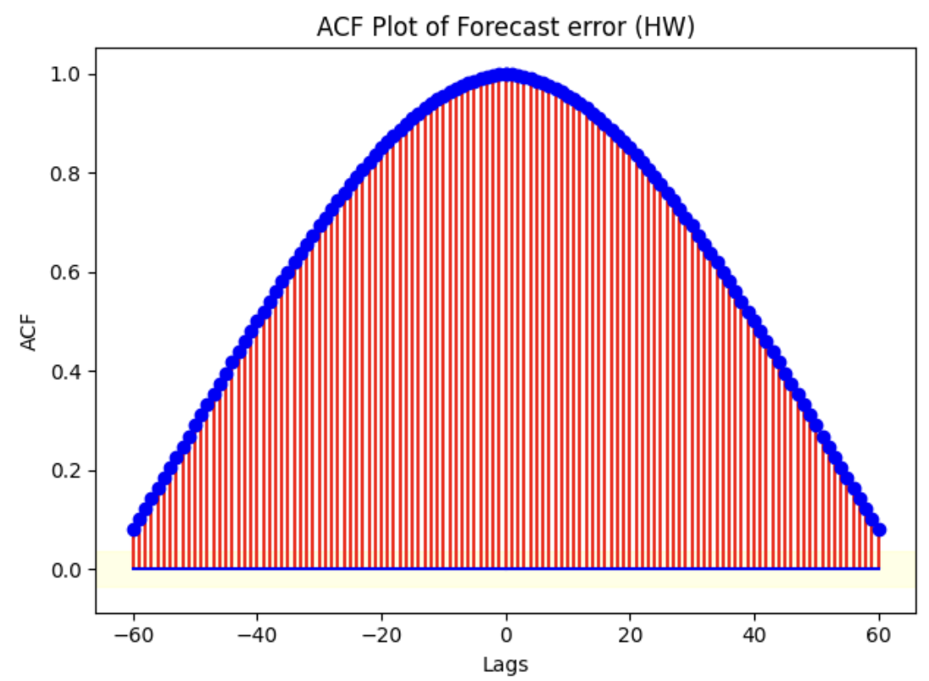
HOLTS-WINTER METHOD - SOUTHERN HEMISPHERE
It’s same in this as well.
The Holts winter model shows that the train , test and predicted is. not fitted. It shows a clear trend over the test set.
The ACF plot of residuals shows that the data is white and converges over time both in the positive and negative lags in a mirrorly manner.
The ACF plot of the forecasted shows that the data is not white and doesn’t converge over time. Even after 60 lags.

Slide 17
PERFORMANCE METRICS OF
HOLT WINTER MODEL/METHOD
Metrics | Northern Hemisphere values | Southern Hemisphere values
MSE TRAIN | 0.00475 | 0.0117
RMSE TRAIN | 0.0689 | 0.1083
Q-VALUE | 0.1285 (lb_pvalue) | 0.4529(lb_pvalue)
MEAN OF RESIDUAL | -7.7038 | 8.998
MEAN OF FORECASTED | 9.9234 | -17.912
VARIANCE OF RESIDUAL | 0.0047 | 0.0117
VARIANCE OF FORECASTED | 18.227 | 60.441
MSE TEST | 116.701 | 381.305
RMSE TEST | 10.802 | 19.527

